Slide 1


Santa Rosa Marble
Doral, United States
February 2021
Hiram Fleitas
Fleitas Arts
github.com/hfleitas/srm
Notes:
Image ref: https://img-prod-cms-rt-microsoft-com.akamaized.net/cms/api/am/imageFileData/RE2x0JM?ver=a32f&q=90&m=6&h=600&w=1600&b=%23FFFFFFFF&l=f&o=t&aim=true

Slide 2
SRM App
Use-Case
Search
Product
Inventory
Sales
Hiram Fleitas
Fleitas Arts
github.com/hfleitas/srm
Notes:
Image ref: https://img-prod-cms-rt-microsoft-com.akamaized.net/cms/api/am/imageFileData/RE2x0JM?ver=a32f&q=90&m=6&h=600&w=1600&b=%23FFFFFFFF&l=f&o=t&aim=true

Slide 3











Hiram Fleitas
Owner Fleitas Arts
Bio
Father
Principal DB Architect
Power Platform since 2016
Developer since 1995
SQL Server since 1999
USCG Auxiliary Flotilla Staff Officer
@hiramfleitas
/hfleitas
hiram@fleitasarts.com
hiramfleitas
fleitasarts.com

Slide 4
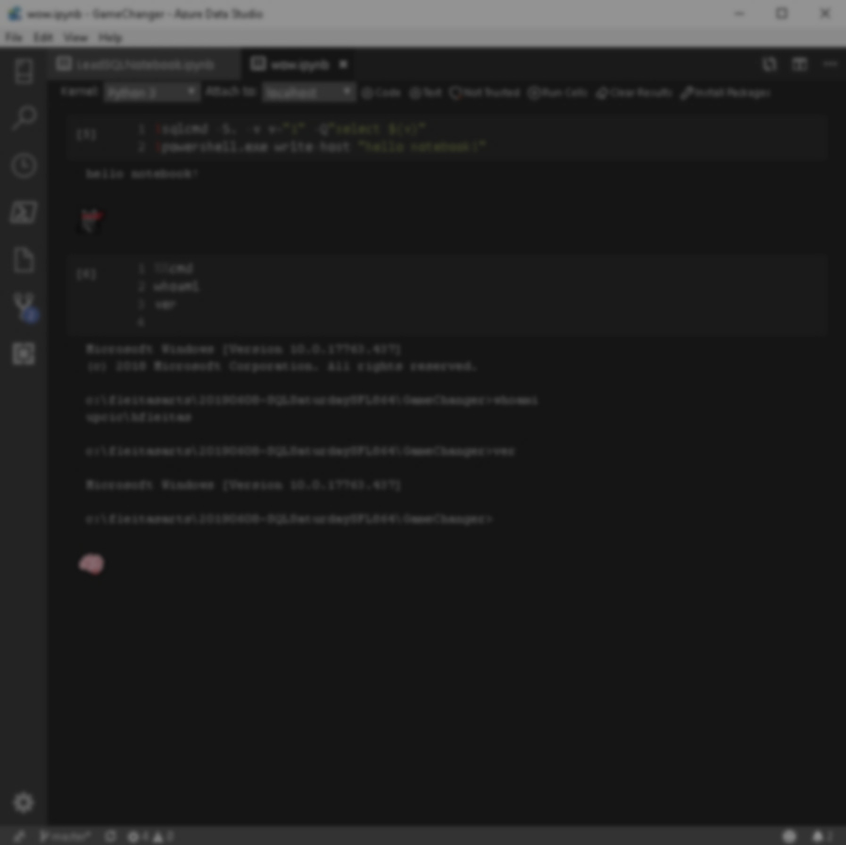

Agenda
Search
Details
Photos
Edit
Add
Cart
Resources

Slide 5

Adapt. Now more than ever.
Work together to meet challenges effectively.
188%
ROI over three years
3.2 hours/day/employee
Average improvement in line-of-business employee productivity
74%
Reduction in app development costs
Notes:
hero_desktop.jpg (2880×1662) (azureedge.net)
https://go.microsoft.com/fwlink/?LinkId=2126953&clcid=0x409

Slide 6




Microsoft Power Platform
One low-code platform that spans Office 365, Dynamics 365, and standalone applications
Analyze. Act. Automate.
Power BI
Business analytics
Power Apps
Application development
Power Automate
Workflow automation
Power Virtual Agents
Conversational chatbots
Data
connectors
Common
data service

Slide 7
Why Power Apps?
Create apps without compromises.
Build professional-grade apps that mean business.
Easily build the business apps you need and extend or customize the apps you already use.
Build apps in hours-not months- that easily connect to data, use Excel-like expressions to add logic, and run on the web, iOS, and Android devices.
Innovate quickly for fast results.
Give everyone the tools to be an app builder.
Gain a competitive advantage by linking all your data.
Connect with tens of thousands of Power Apps community members around the world, and discover valuable tips from the Microsoft Power Apps team and Champions.

Slide 8


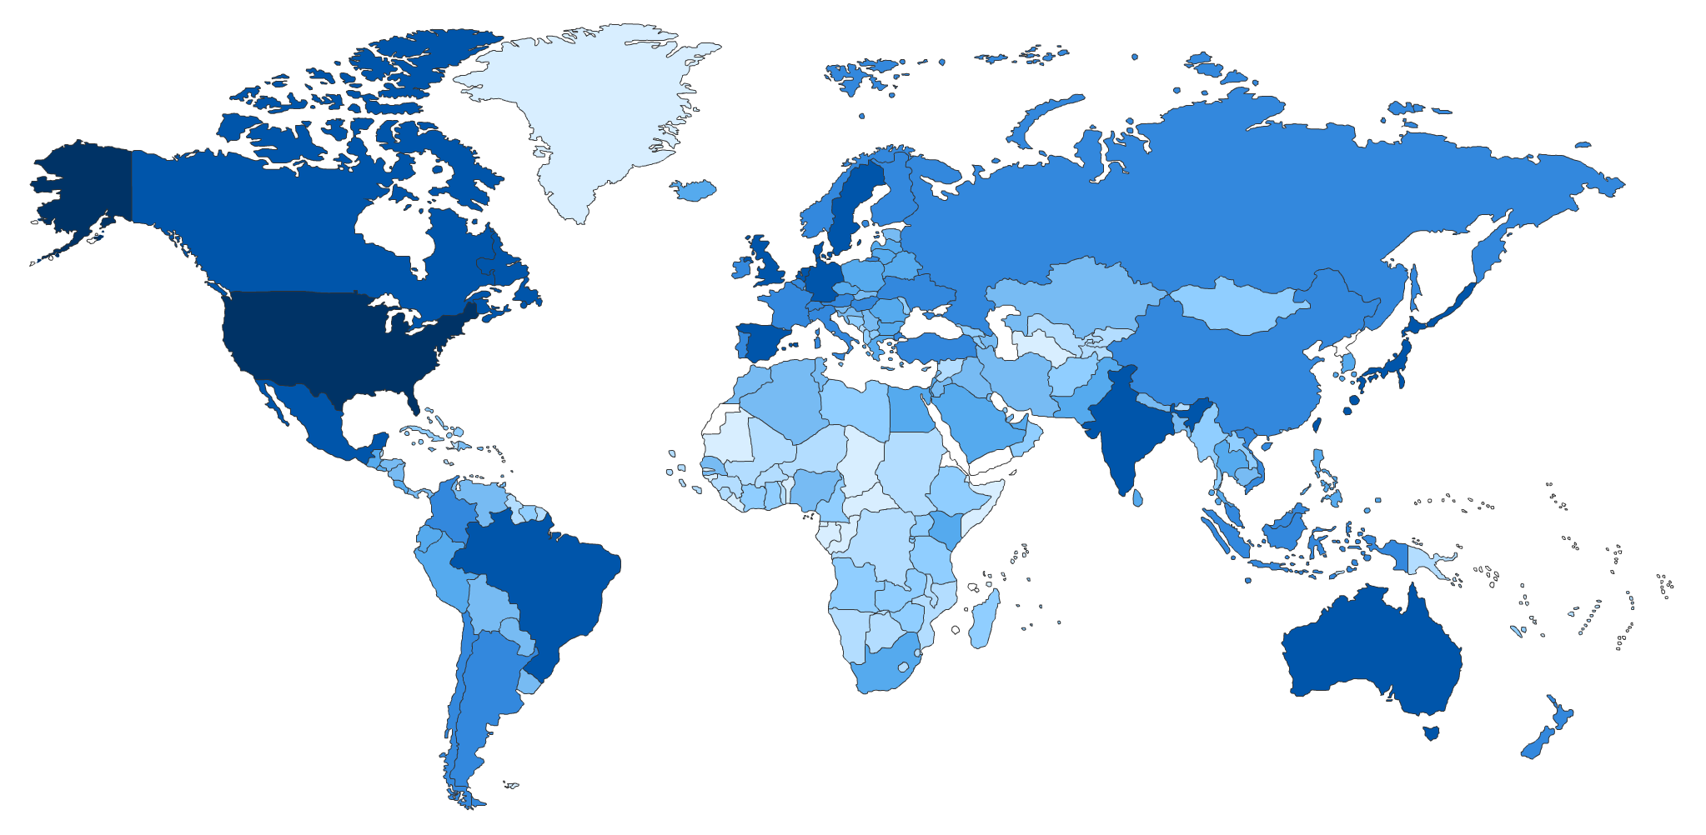








Global Scale and Enterprise Readiness
18,000 Cities globally access the service daily
190 Countries & territories
43 Languages
Global coverage
19 datacenters worldwide
National Clouds
US Government
China
Germany
Shaded areas show countries with Power BI usage. The darker the color the greater the number of users
Notes:
This slide covers 2 points.
1. The global Scale of Power BI, Power BI has the largest global footprint of any Self Service BI tool. It is available in 19 DCs around the world, it’s available most countries around the world and in 43 languages.
2. Second, Power BI is Enterprise Ready. It supports all the Industry and Government required Security certifications like HIPAA, EU Model Closes, FedRAMP, etc. It is also available in the National Clouds in the US, Germany and China, which means that it can be used by All government entities.

Slide 9
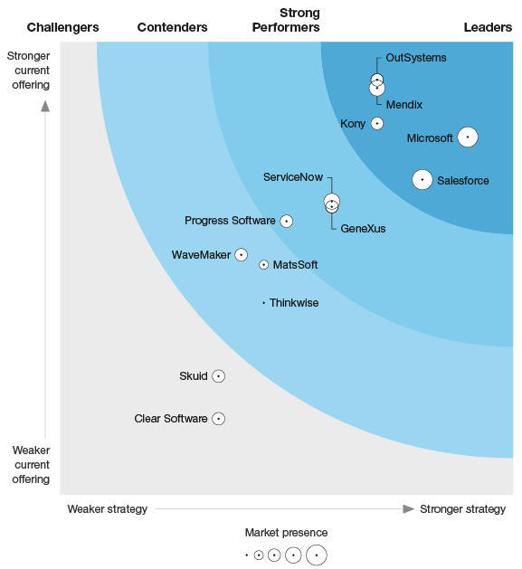

Q1 2019
Named Microsoft as a leader in
The Forrester Wave™: Low-Code Development Platforms For AD&D Professionals
READ REPORT >
The Forrester Wave™ is copyrighted by Forrester Research, Inc. Forrester and Forrester Wave™ are trademarks of Forrester Research, Inc. The Forrester Wave™ is a graphical representation of Forrester's call on a market and is plotted using a detailed spreadsheet with exposed scores, weightings, and comments. Forrester does not endorse any vendor, product, or service depicted in the Forrester Wave™. Information is based on best available resources. Opinions reflect judgment at the time and are subject to change.

Slide 10

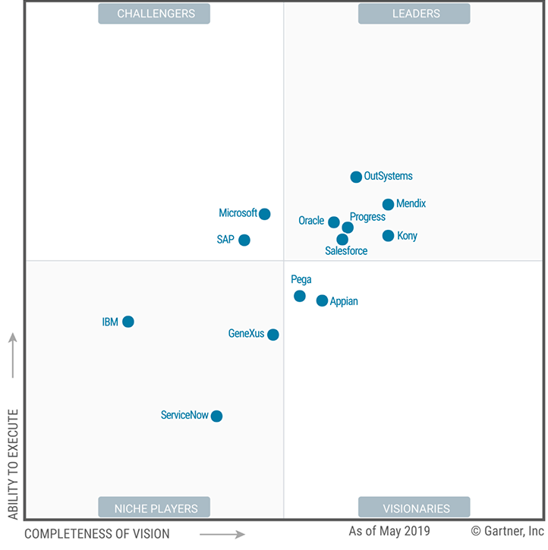
July 2019
Named Microsoft as a Challenger in the Magic Quadrant for Multiexperience Development Platforms
READ REPORT >
This graphic was published by Gartner, Inc. as part of a larger research document and should be evaluated in the context of the entire document. The Gartner document is available upon request from Microsoft. Gartner does not endorse any vendor, product or service depicted in its research publications, and does not advise technology users to select only those vendors with the highest ratings or other designation. Gartner research publications consist of the opinions of Gartner's research organization and should not be construed as statements of fact. Gartner disclaims all warranties, expressed or implied, with respect to this research, including any warranties of merchantability or fitness for a particular purpose.
Notes:
This is the first Magic Quadrant for multiexperience development platforms (MXDPs), its predecessors having been Magic Quadrants for mobile app development platforms (MADPs). The change of name reflects the evolution of MADPs to serve expanding app use cases and development requirements. These requirements go beyond mobile apps to enable development of progressive web apps (PWAs), conversational apps (voice assistants and chatbots), immersive apps and wearable apps.
Microsoft
Microsoft is a Challenger. In the MXDP market, enterprises often consider Microsoft because its suite of Visual Studio and Azure products is known to meet the needs of professional developers. Its PowerApps and Flow products are increasingly used by IT and citizen developers, too. Together, these products form a platform suite that is widely adopted for multiexperience development, although Microsoft lacks a formal platform naming and packaging convention.
Strengths
Product capabilities: Visual Studio with Xamarin offers native-level mobile app development, while Microsoft Bot Framework supports conversational app development for both voice and chatbot use cases. Microsoft is also one of the vendors at the forefront of supporting PWA and immersive app development.
Viability and operations: Microsoft has a massive developer community and ecosystem for all the products under its MXDP umbrella. By taking an unopinionated approach to its development platform, Microsoft allows customers to use what they need and to interchange other product and components comparatively easily. Operationally, Microsoft has significant resources to support and invest in its MXDP offering.
Market responsiveness: Microsoft embraces open-source technologies and has been active not only in its .NET Core community, but also in the Apache Cordova, React Native and Linux Foundation communities. It also offers a number of marketplaces for Visual Studio and Azure, plus the GitHub Marketplace through its acquisition of GitHub.
Cautions
Market understanding and marketing strategy: Microsoft markets to developers and takes a bottom-up go-to-market approach to its MXDP offering — more so than the other vendors in this Magic Quadrant. Although it is important to win the hearts and minds of developers, Microsoft lacks a higher-level, unified strategic value proposition for its MXDP for IT and business leaders, who are the final decision makers.
Sales strategy: Microsoft gains customers for its MXDP platform suite as a strong incumbent supplier of developer tools and platform services in many enterprises. However, potential customers may find that its sales support and licensing models are less coordinated and focused than other vendors from a platform-centric perspective.
Business model: Although Microsoft has taken a leadership position in many open-source areas to expand its technology scope, it does not demonstrate a compelling vision to monetize that activity for its MXDP (its PWA Builder and Visual Studio Code products, for example, are evidence of this). Also, with engineering and go-to-market responsibilities spread across Azure, Visual Studio and Business Applications teams, Microsoft currently lacks a cohesive platform business model that ties together its MXDP products.

Slide 11

Home
Search by Name or Code.
Search by Picture
Go to Cart
Help
View items in Mixed-Reality

Slide 12
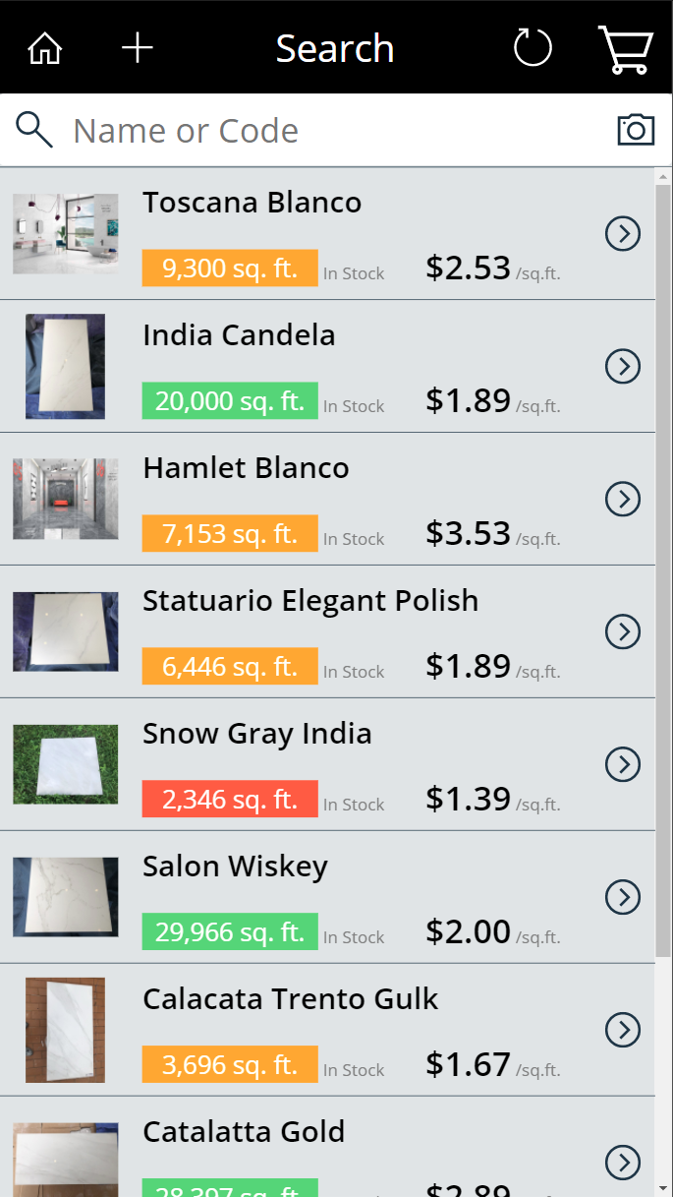
Search
Back Home
Add Product (Access Control)
Refresh Screen
Go to Cart
Search (type input)
Search by Photo
Primary Photo (Go to Photos)
Name
Total Sqft in stock (Color coding based on Threshold)
Price per sqft.
Go to Details

Slide 13
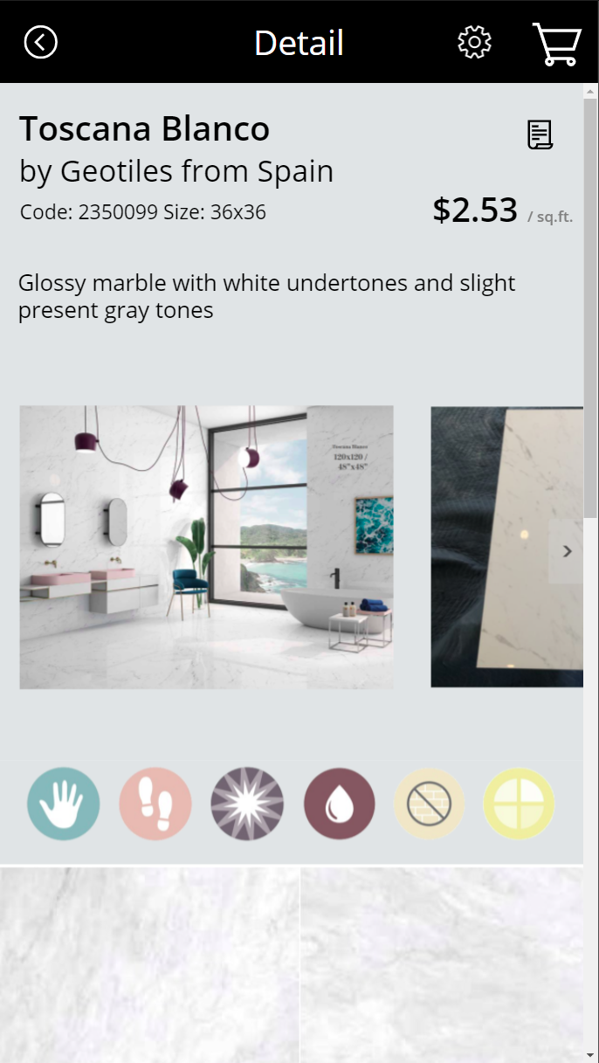
Detail
Back to Search
Edit (Access Control)
Go to Cart
Go to Manufacture Catalog
View Cost (Access Control)
Photos (Scroll Horizontal, Go to Photo when pressed)
Detail page (Scroll Vertical)

Slide 14
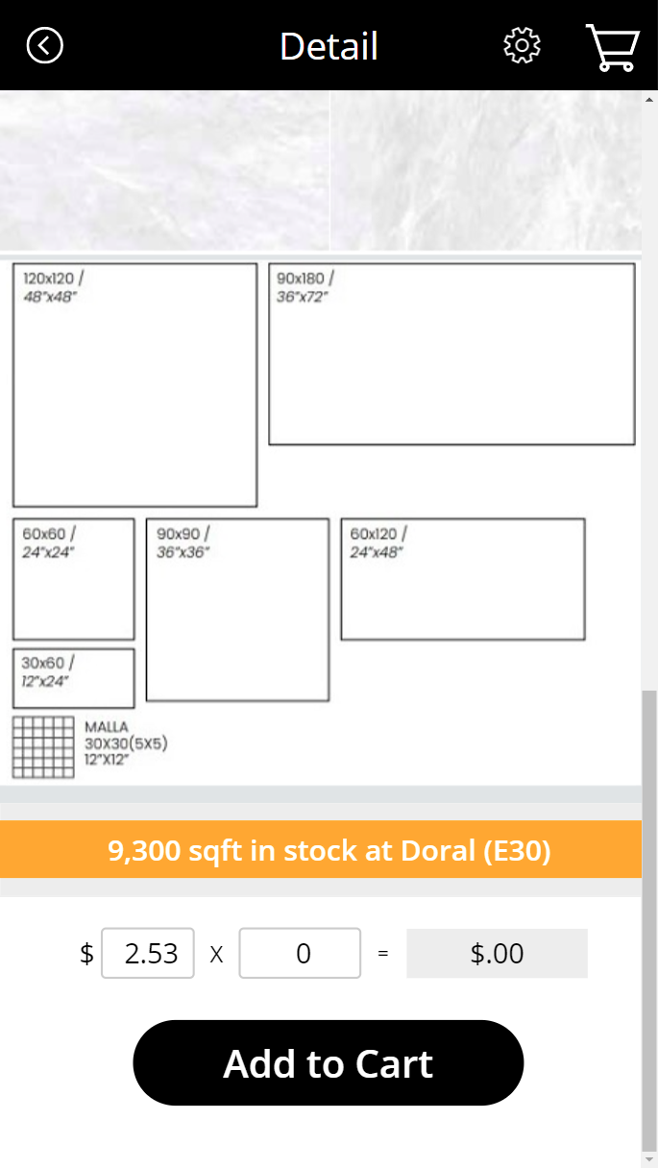
Detail
Full product & inventory details.
Inventory info and location (Pending add Tone info)
Add to Cart desired sqft quantity. (Shows Total $ for Quantity and Goes to Cart)
Edit Price (Access Control) when adding to Cart to apply discount.
Shows sum $ discount amount.

Slide 15
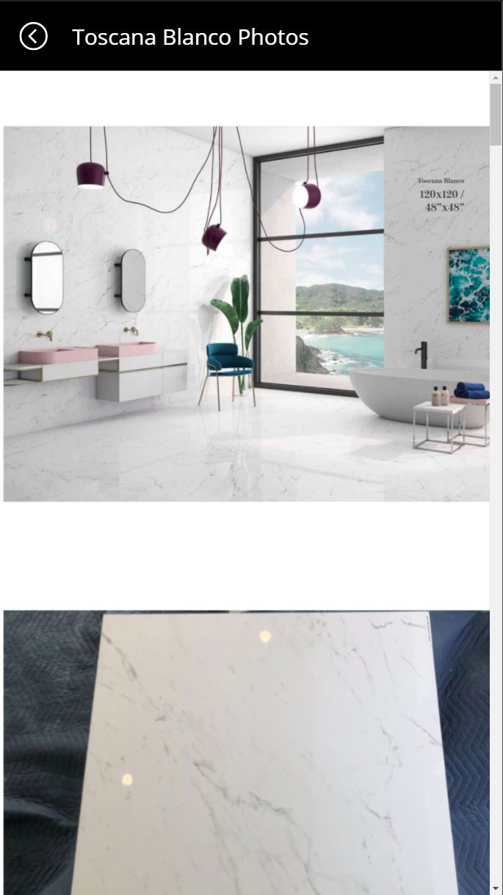
Photos
Go Back
Zoom into Photos using Pinch gesture
Unlimited Photos (Import Automatable)

Slide 16
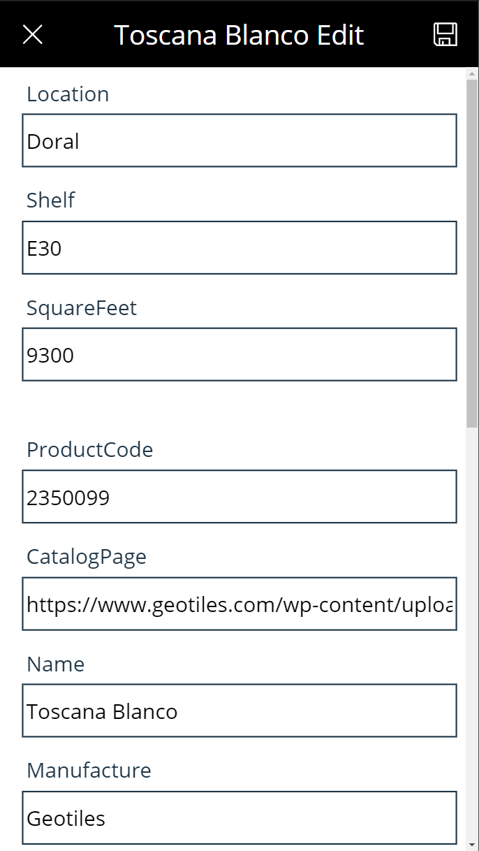
Edit
Cancel (Go Back) / Save changes.
Edit all fields of an existing product.
Primary key ProductCode for consistency between Product and Inventory.
Access Control
Audit, Security & Backups in-place.

Slide 17
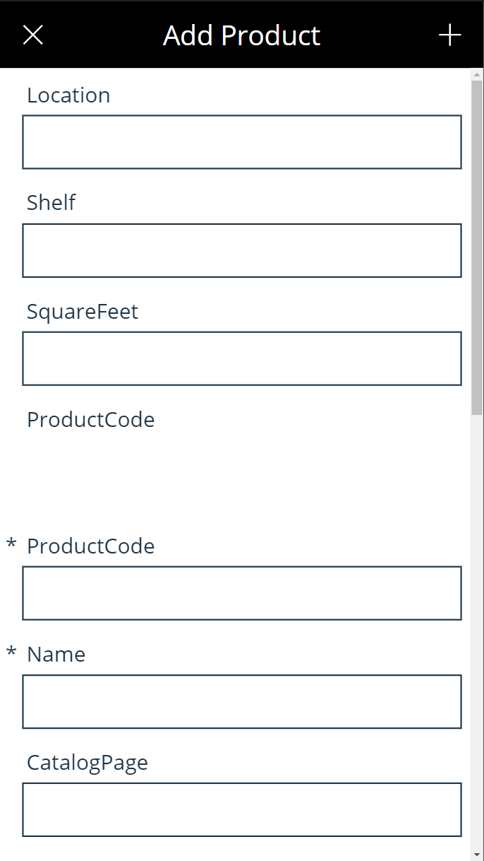
Add
Cancel (Go Back) / Add new product.
Add info for all fields.
ProductCode and Name are the 2 required fields.
All fields can be Edited after.
Primary key ProductCode for consistency between Product and Inventory.
Access Control
Audit, Security & Backups in-place.
Unlimited Products (Import Automatable)

Slide 18
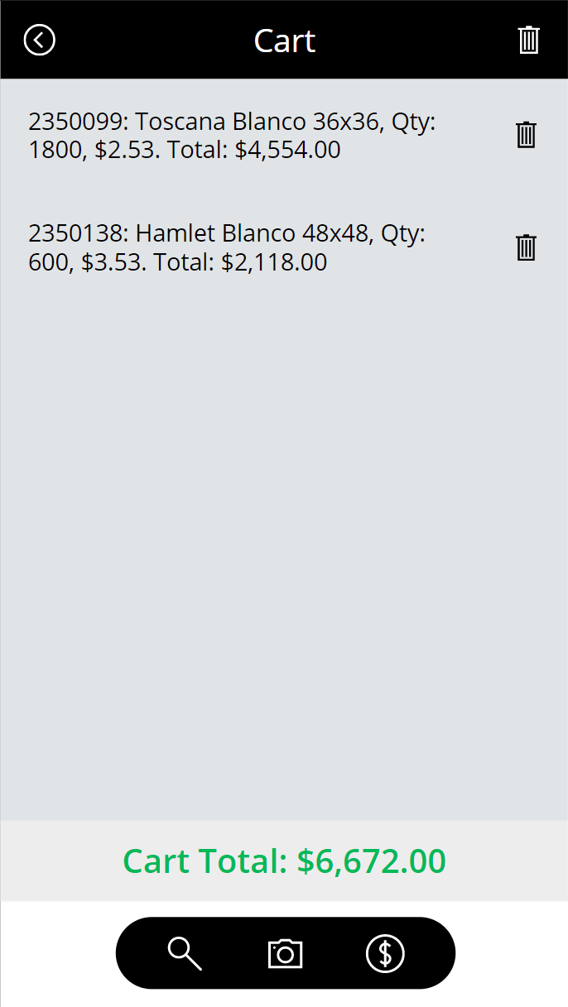
Cart
Go Back (Continue Shopping, doesn’t clear cart).
Clear Cart.
Items in Cart with Sub-totals.
Delete individual item from Cart.
Cart Total.
Back to Search (Continue Shopping)
Search by Photo (Continue Shopping)
Checkout (Emails Cart to Cashier at Point-of-Sale system)
Sales Report

Slide 19

DEMO 1
App Intro
Notes:
SRM - Power Apps

Slide 21
DEMO 2
Cart
Notes:
SRM - Power Apps

Slide 23
DEMO 3
Edit / Add Product
Notes:
SRM - Power Apps

Slide 25
DEMO 4
Photos
Notes:
SRM - Power Apps

Slide 27
DEMO 5
Bonus: Ai Features, Analytics
Notes:
SRM - Power Apps

Slide 29


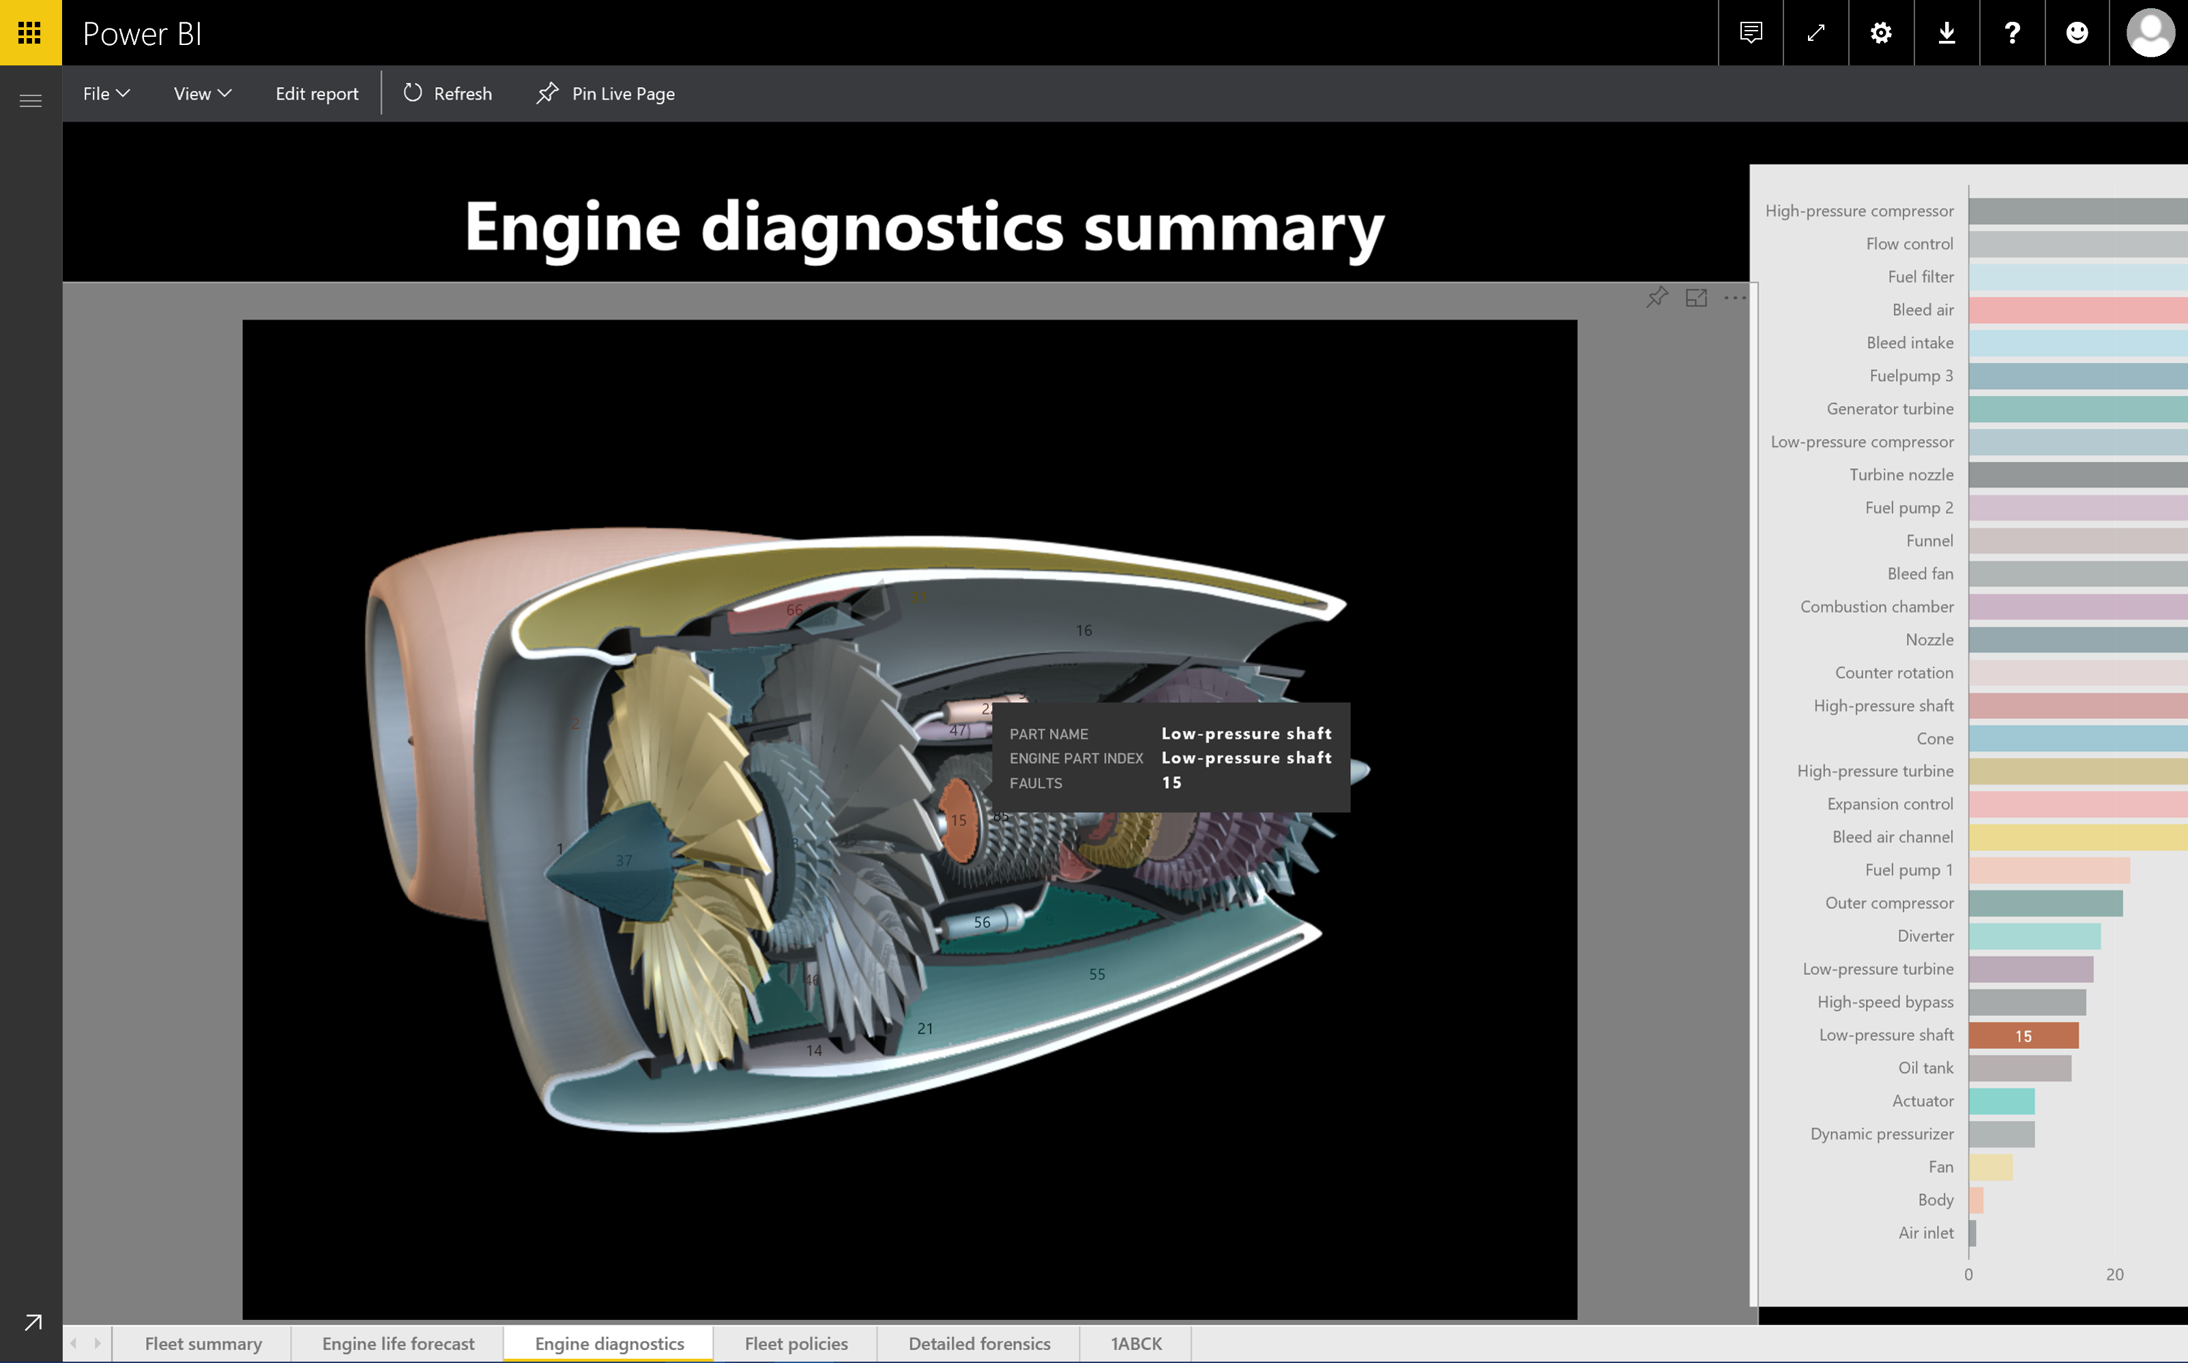
More
to come.

Slide 30
Summary
Search
Details
Photos
Edit
Add
Cart
Search by Photo (AI)
Mixed Reality (AI)
Resources

Slide 31
Resources
SRM - Power Apps v128
fleitasarts.com
github.com/hfleitas/srm
ROI Case Study
Notes:
SRM - Power Apps

Slide 32
Hiram Fleitas
Owner Fleitas Arts
@hiramfleitas
Thank You
hiram@fleitasarts.com
fleitasarts.com
/hfleitas
hiramfleitas

